Slide 1
Tuples
Notes:
In this lesson we’re going to talk about one of the most important data types in python: Strings.

Slide 2
Tuples
We’ve seen that lists are flexible: we can add, remove, and modify elements.
But sometimes we want data that should not change.
For this, Python provides tuples.
Tuples use parentheses () instead of square brackets.
dimensions = (200, 50)
dimensions # (200, 50)

Slide 3
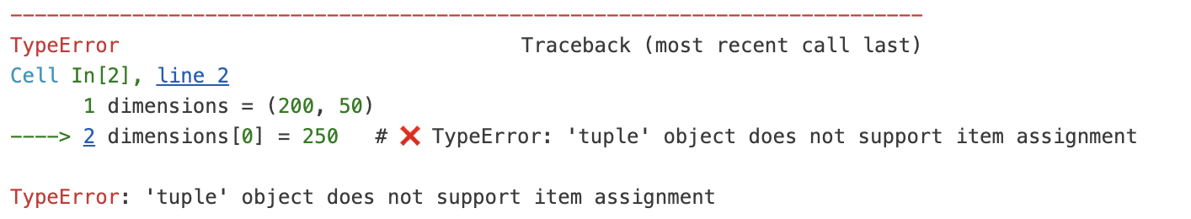
Tuples
Unlike lists, once a tuple is created, its elements cannot be changed.
You can’t add, remove or modify the items in a tuple
dimensions = (200, 50)
dimensions[0] = 250 # ❌ TypeError:

Slide 4
Tuples
There are other ways to create tuples.
Converting from a list using the tuple() function.
If you are assigning to a variable, you can omit the parenthesis
colours = ["red", "green", "blue"]
colours_tuple = tuple(colours)
colours_tuple # ('red', 'green', 'blue')
colours = "red", "green", "blue"
colours # ('red', 'green', 'blue')

Slide 5
Why use tuples?
Tuples are useful when:
You want to protect data from accidental changes.
You’re working with fixed values (like coordinates, screen sizes, settings).
They can also be used as keys in dictionaries (lists cannot).

